Slide 1
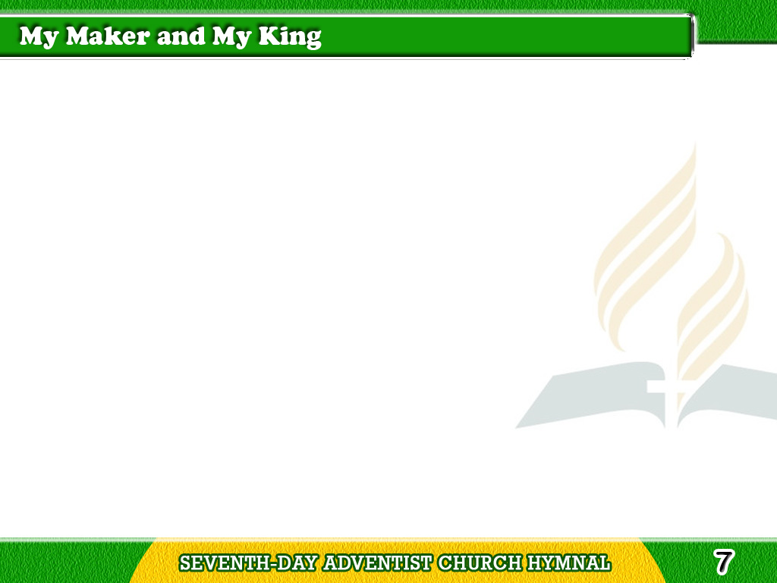
1/4
My Maker and my King,
To Thee my all I owe;
Thy sovereign bounty
is the spring
Tagalog
Version

Slide 2
1/4
Whence all my blessings flow;
Thy sovereign bounty
is the spring
Whence all my blessings flow.
Tagalog
Version

Slide 3
2/4
The creature of Thy hand,
On Thee alone I live;
My God, Thy benefits demand
Tagalog
Version

Slide 4
2/4
More praise than I can give.
My God, Thy benefits demand
More praise than I can give.
Tagalog
Version

Slide 5
3/4
Lord, what can I impart
When all is Thine before?
Thy love demands
a thankful heart;
Tagalog
Version

Slide 6
3/4
The gift, alas! how poor.
Thy love demands
a thankful heart;
The gift, alas! how poor.
Tagalog
Version

Slide 7
4/4
O! let Thy grace inspire
My soul with strength divine;
Let every word
and each desire
Tagalog
Version

Slide 8
4/4
And all my days be Thine.
Let every word and
each desire
And all my days be Thine.
Tagalog
Version

